Slide 1

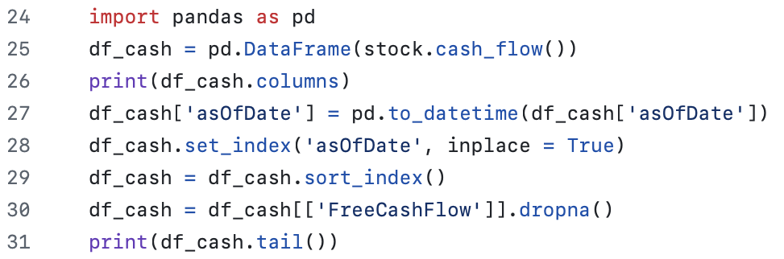
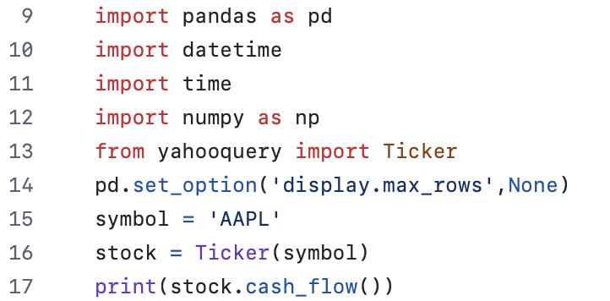

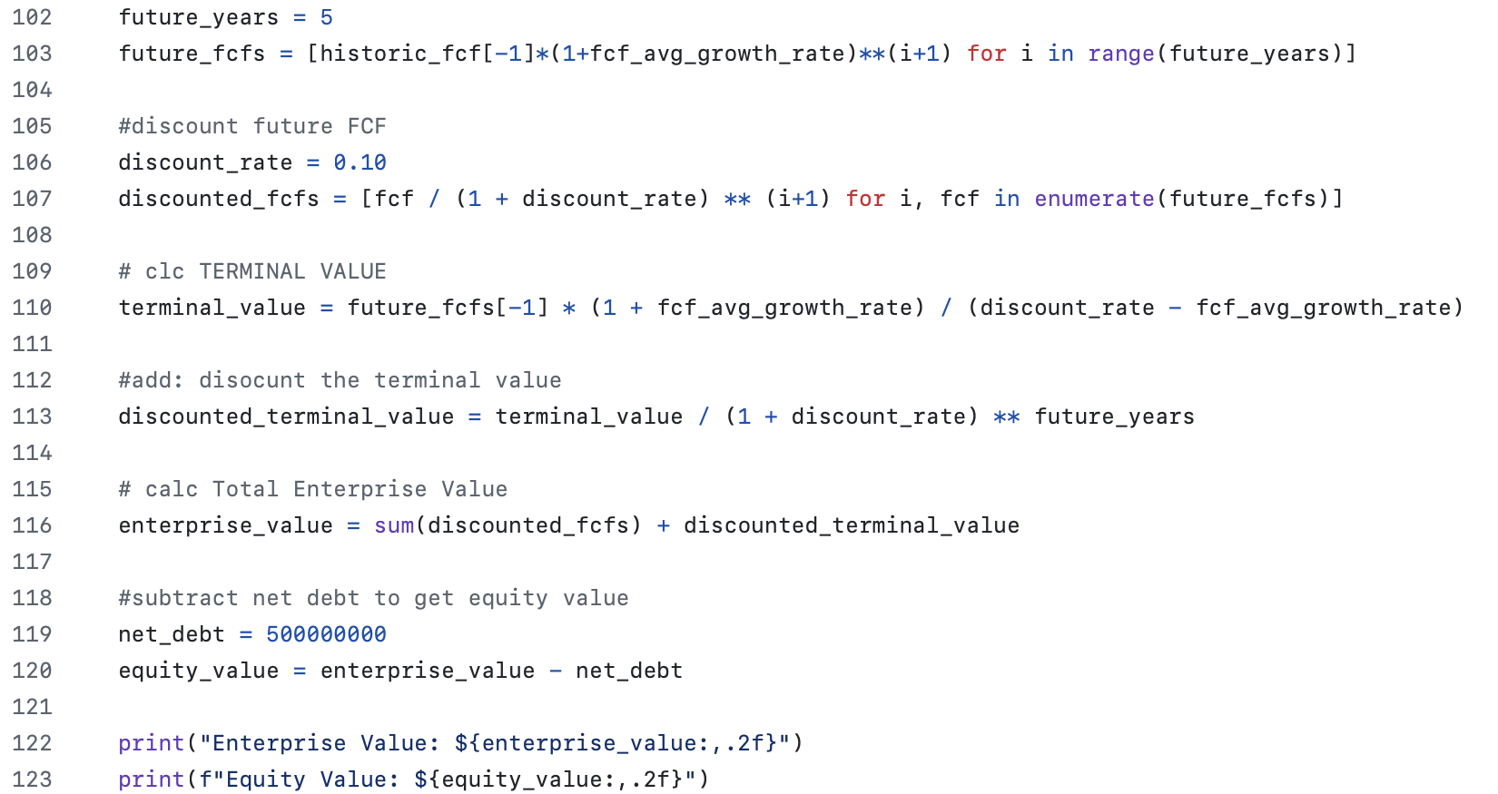



A Cash Flow Forecasting & Valuation Tool
By: Cristal Lopez
Transforming Financial data into valuation insights – one cash flow at a time.
Pulls real-time financials using Yahoo Finance.
Forecasts Free Cash Flow over 5 years
Calculates Terminal Value, Enterprise Value and Equity Value
Helps investors make wiser stock decisions.

